Slide 1
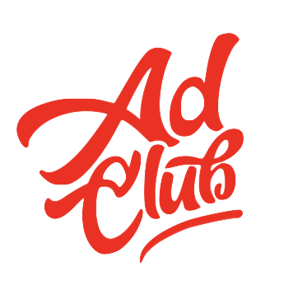
Agency Info Meeting
February 28, 2023

Slide 2
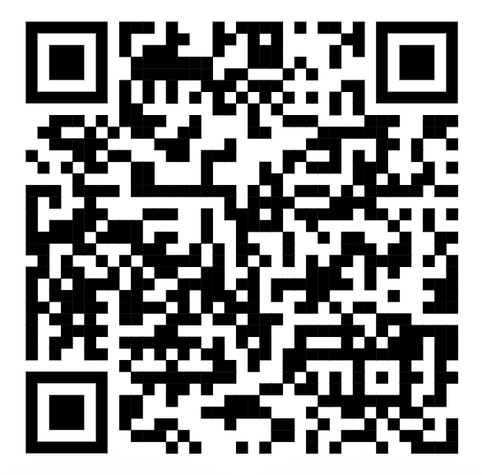
Attendance

Slide 3
WHAT IS AN AGENCY?
An advertising agency is a professional service firm hired by other businesses, corporations, non-profits, and government agencies to ideate, produce, and manage the showing of advertisements in different mediums.
TYPES:
Full-service advertising agency
Digital advertising agency
Creative boutique
Media buying agency

Slide 4
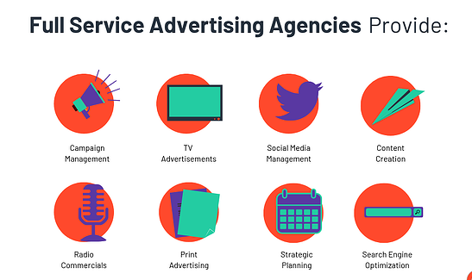
Full-Service Advertising Agency
Just what it sounds like: an agency that does anything and everything for their client.
22squared
360i
Blue Sky Agency
Fitzco
BBDO Atlanta
Chemistry Agency
Notes:
These agencies will be able to help throughout the entire advertising process, from planning to execution to measuring advertising effectiveness.

Slide 5
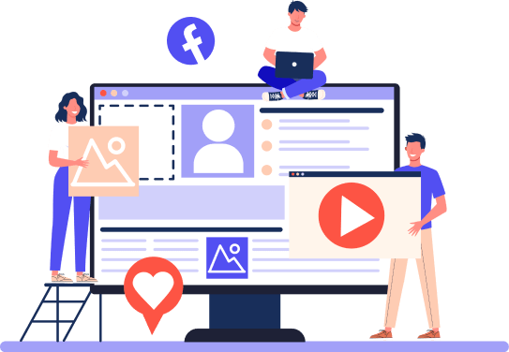
Digital Advertising Agency
While full-service agencies do a little bit of everything, digital advertising agencies really hone in everything digital, meaning that the work doesn’t have to stop at just SEO and web design.
Graphic designers, videographers, copywriters, and photographers are all mixed into this group.
Nebo
Publicis Sapient
Vert
Response Mine Interactive
Morrison
Notes:
These agencies will be able to help with anything on-screen, including:
Search engine optimization (SEO)
Social media marketing
Web design
Email marketing
Content marketing
Digital advertising agencies are great for companies that have a specific audience in mind because they reach that exact audience.

Slide 6
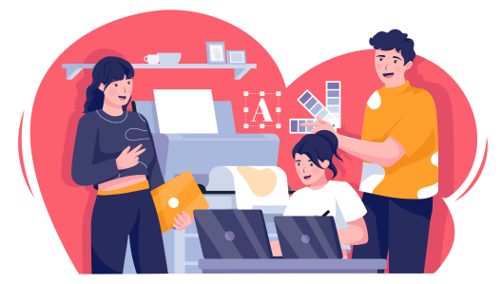
Creative Boutique
Creative boutiques are agencies that specialize in creative design services. These agencies were developed because some companies prefer to monitor their success and place advertisements on their own, but don’t have the creative talent to produce the appropriate designs and copy for them.
The Seed Factory
Tailfin
The Super Group
Notes:
Creative boutiques are best for companies that know exactly what they want and know how to implement those assets into their advertisements appropriately.
A creative boutique is much smaller than a full-service agency, meaning the expenses will be significantly less.

Slide 7
Media Buying Agency
Arguably the inverse of a creative boutique, a media buying agency works to place creative advertising materials in the most optimal locations, whether they’re printed or digital.
Carat
Atlanta MediaWorks
Sideqik
We are Rosie
Notes:
These agencies will recommend a time frame in which to advertise a product or service & the amount a company should be spending for best results.
A media buying agency works with target audience & advertising platforms to ensure maximum exposure.

Slide 8
Top Agencies
Like 99% of agencies are owned and operated under one of these companies
WPP
Wunderman Thompson, VMLY&R, Grey, JWT, Ogilvy & Mather
Omnicom
BBDO, TBWA, Ketchum,
Publicis Groupe
Publicis Communications, Publicis Media, Publicis Sapient, and Publicis Health
Interpublic Group
McCann Worldgroup, FCB, and Lowe & Partners
Dentsu
360i, Carat, iProspect, Merkle
Notes:
These agencies will recommend a time frame in which to advertise a product or service & the amount a company should be spending for best results.
A media buying agency works with target audience & advertising platforms to ensure maximum exposure.

Slide 9
ATL/ATH Agencies
ATL
Publicis Sapient
Formerly Known as
22 Squared
BBDO
Nebo
Chemistry
Marketwake
Social Club
Vert Digital
ATH
See Spark Go
The Adsmith
MORE creative agency
Talking Dog
Kaptiv8
Evolvs

Slide 10
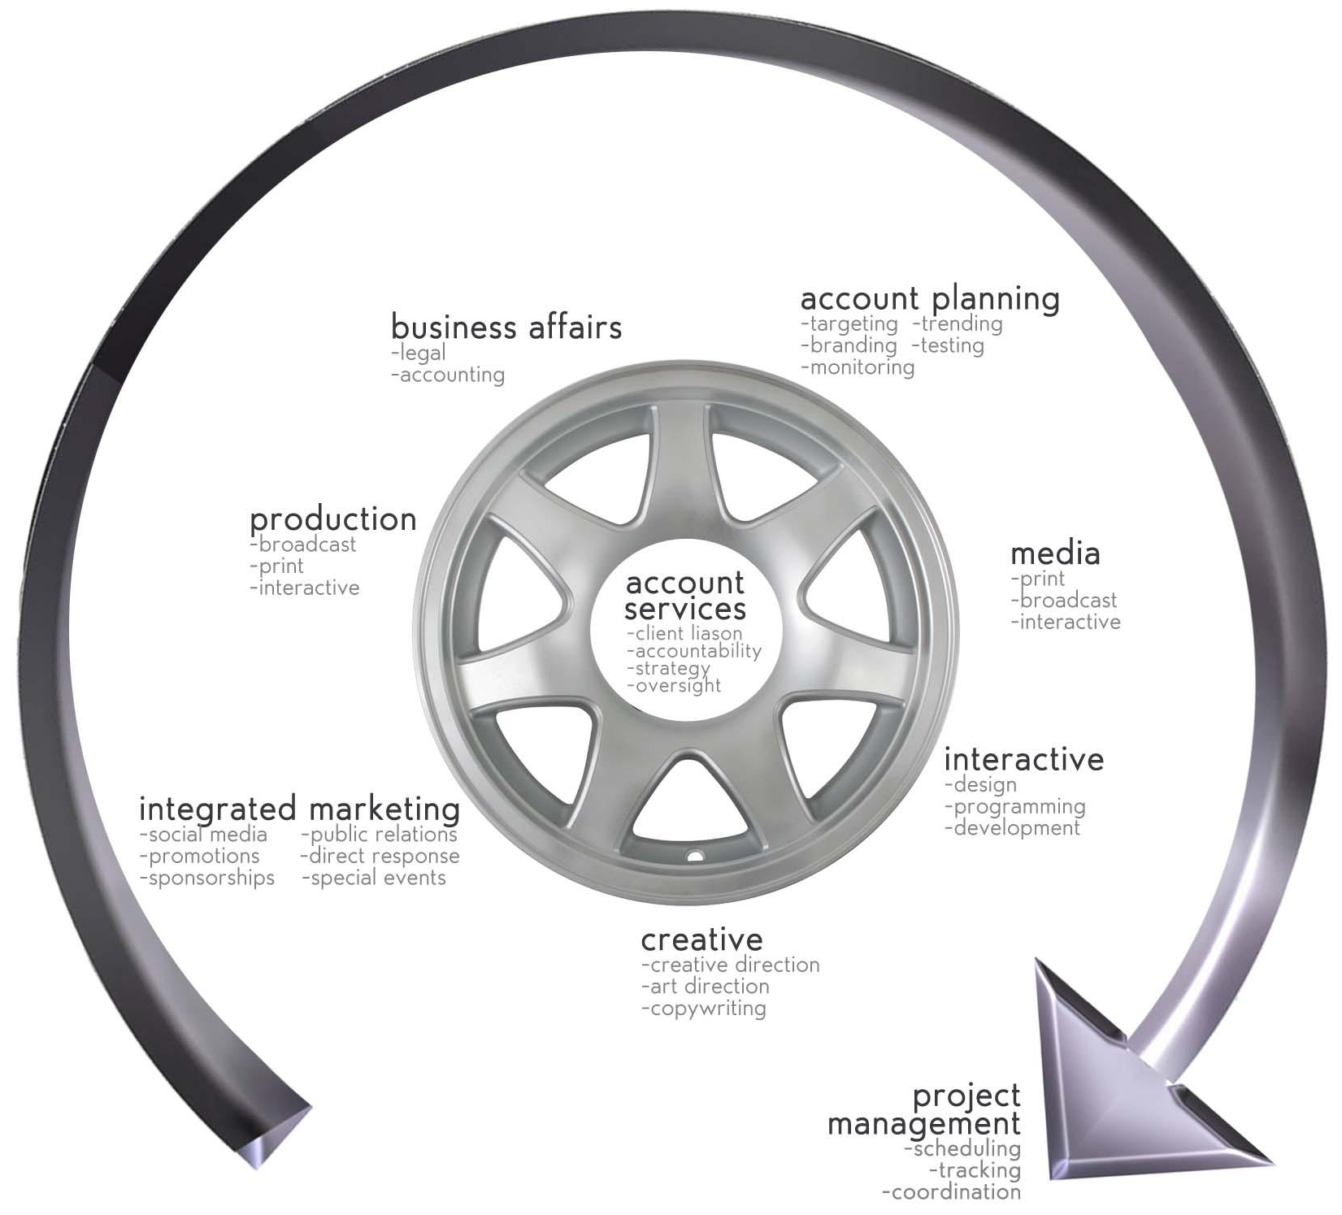
A TRADITIONAL
AGENCY STRUCTURE

Slide 11
a modified agency structure

Slide 12
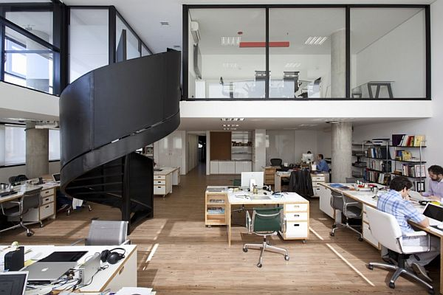
AGENCIES HAVE PERSONALITIES & MINDSETS
-strategic/process-driven
-free thinking
-creative is king
-counter culture
-anti-advertising
-collaboration
-historic/principles-focused
-corporate
-client needs-dedicated
-brand storytellers
-consumer advocates

Slide 13
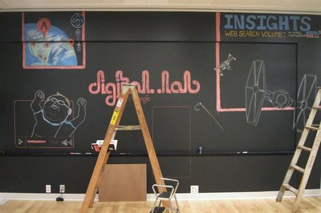
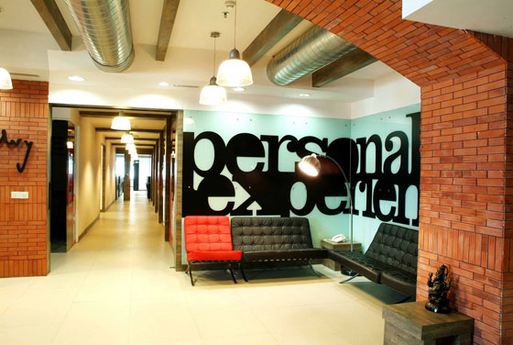
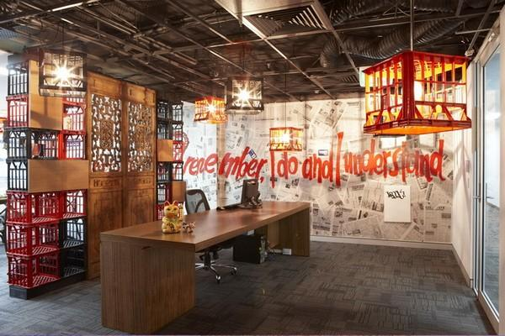
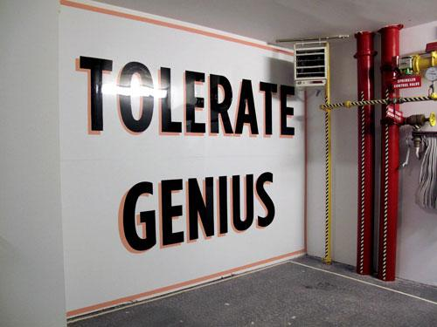
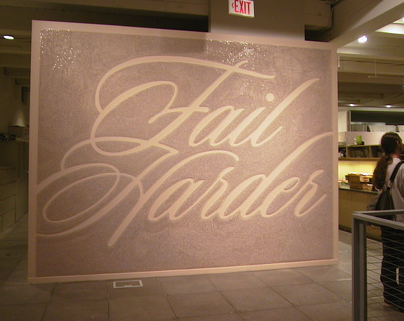
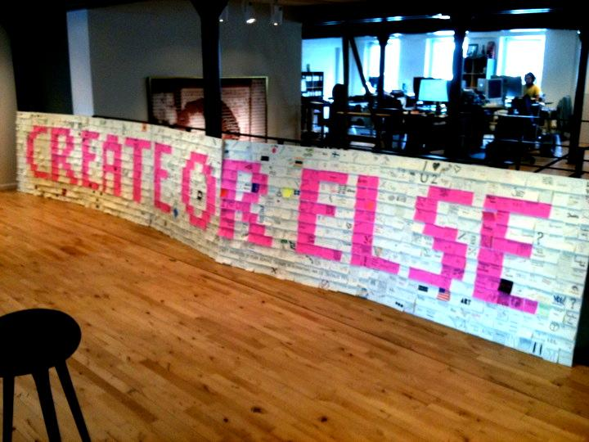
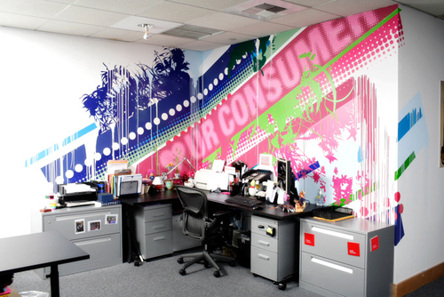
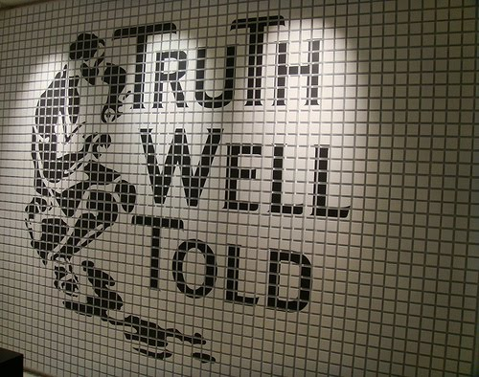
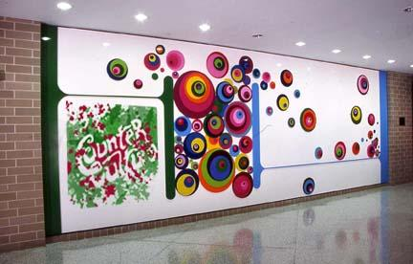
AGENCIES LIVE BY MOTTOS

Slide 14
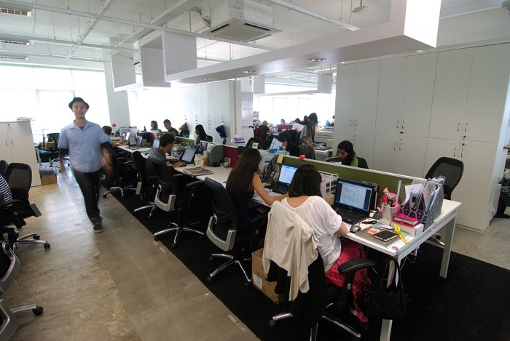
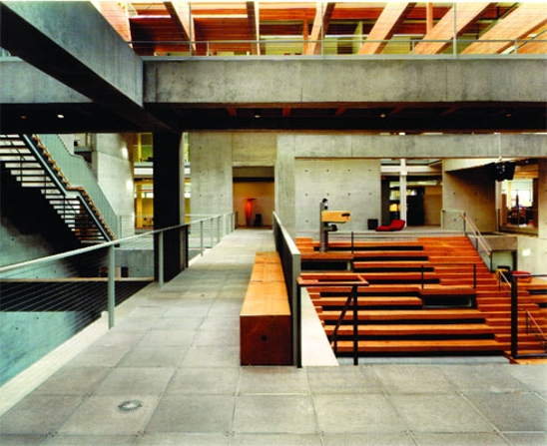
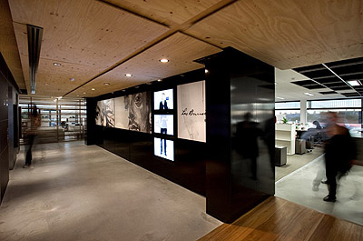
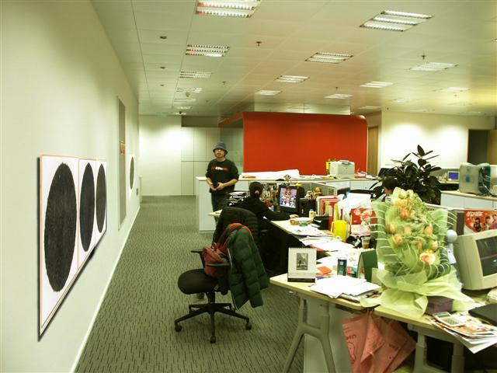
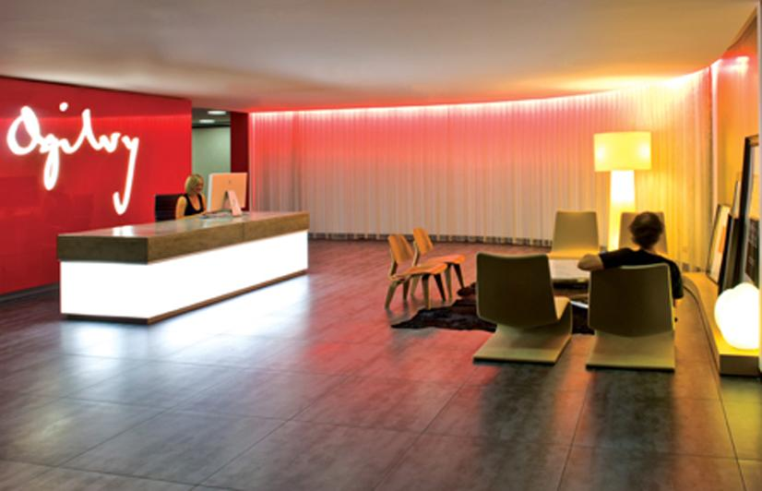
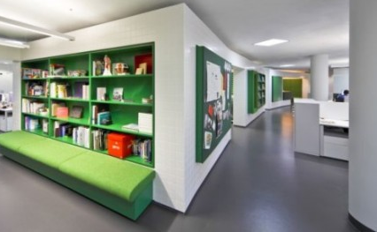
PROS
-training programs
-high profile clients
-varied categories
-upward mobility
-strong resources
-global networks

Slide 15
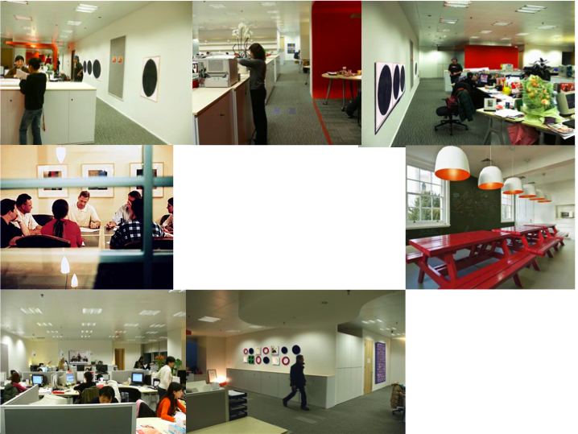
CONS
-limited face time
with clients
-siloed departments & narrow roles
-limited mentor accessibility
-heavy policy & procedure

Slide 16
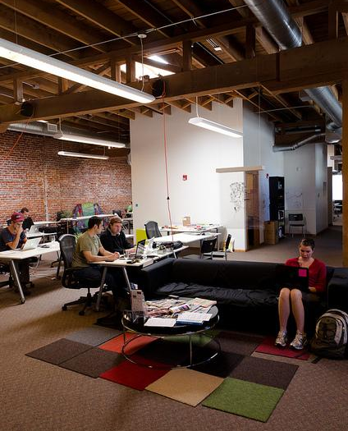
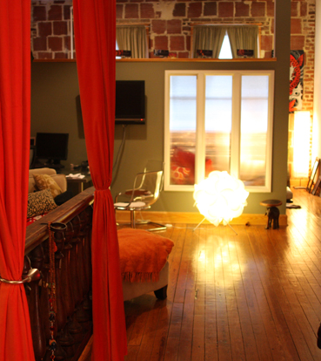
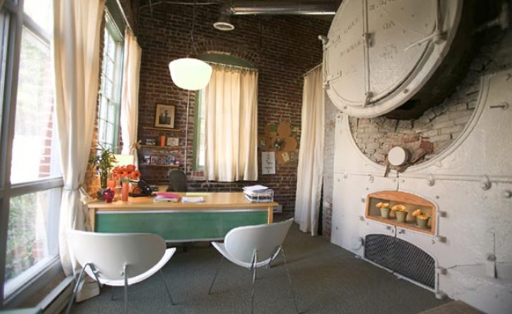
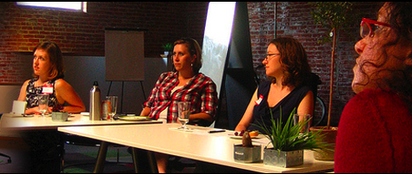
PROS
-multiple touch points
-client contact
-even playing field
-casual atmosphere
-creative license/mold breaking

Slide 17
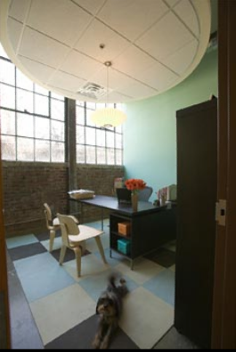
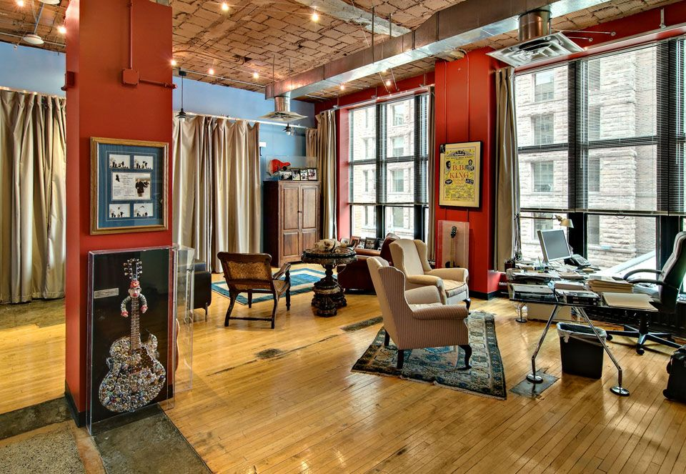
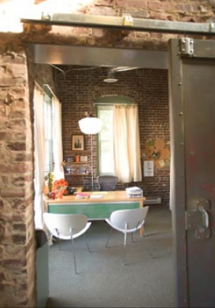
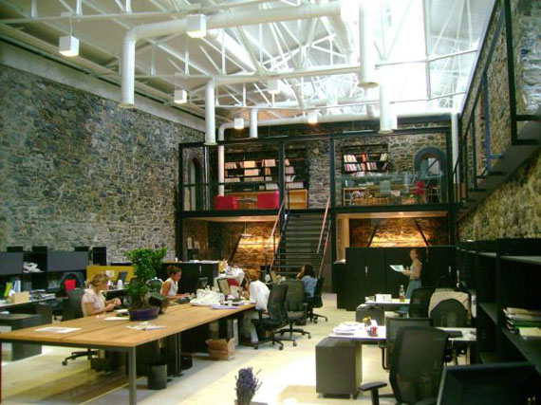
CONS
-local & regional clients
-lack of formal training programs
-limited career growth
-no lateral opportunities
-inability to absorb loss

Slide 18
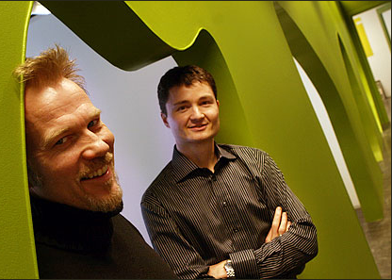
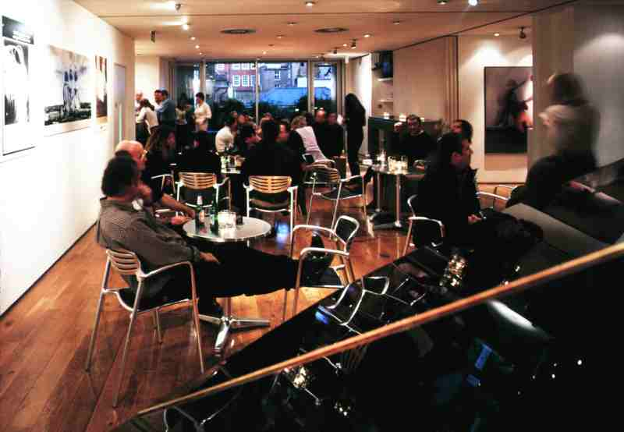
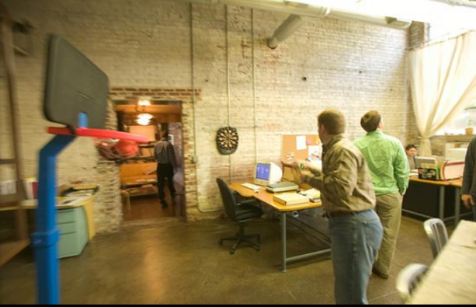
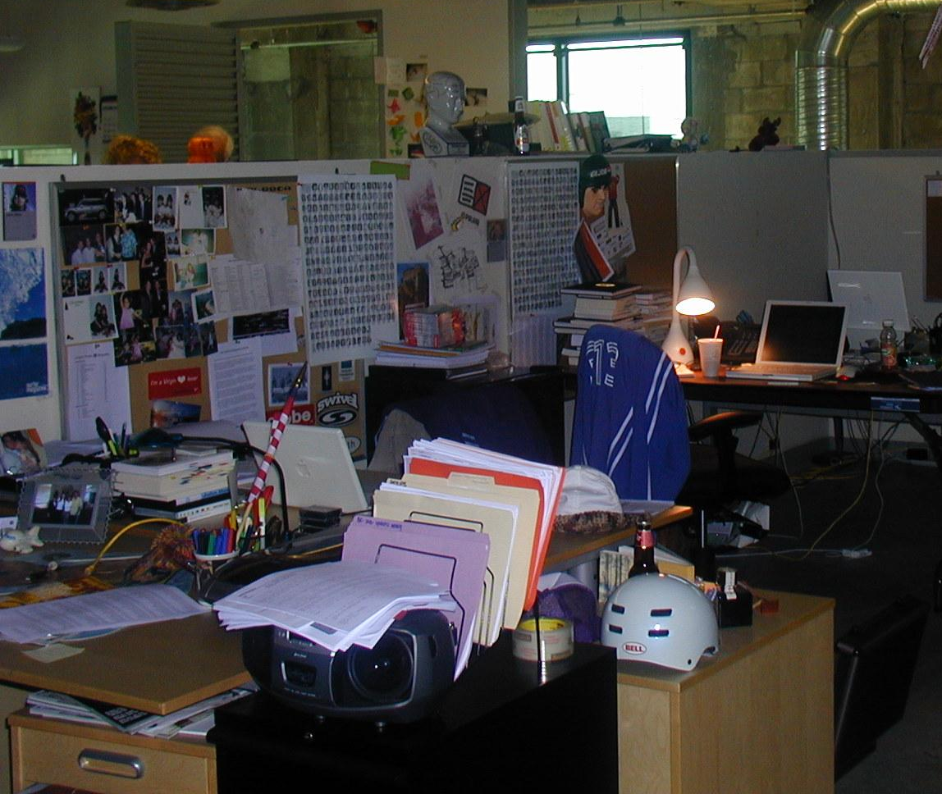
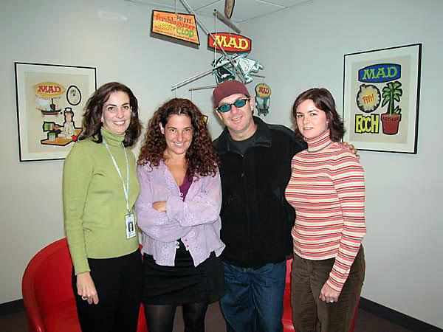
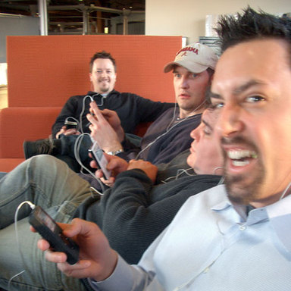
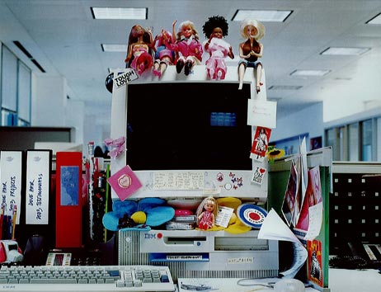
-work hard/play hard
-dynamic experience
-embrace pop culture
-become category expert
-meet interesting people

Slide 19
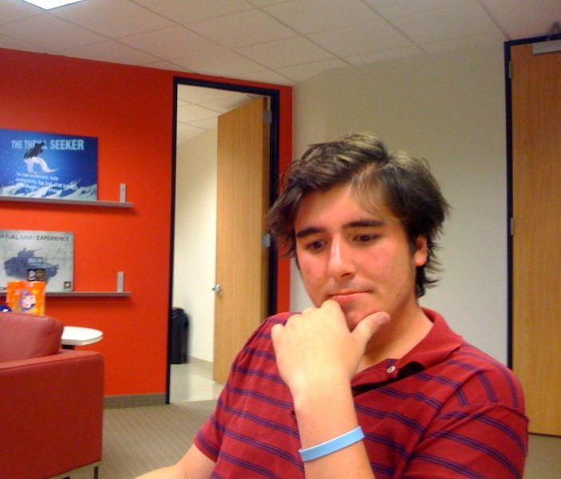
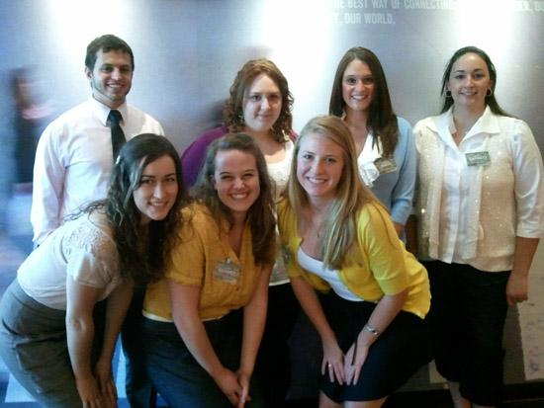
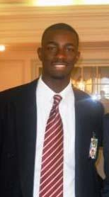
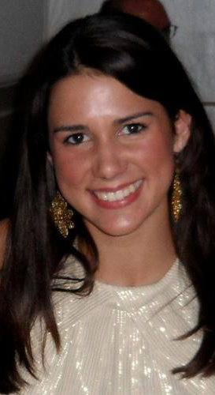
FIND ONE THAT’S A GOOD FIT FOR YOU
-Informational Interviews
-Internships
-Freelance/Project Work
-Shadowing opportunities
(AdClub Shadow for a Day)
-Mentorship programs

Slide 20
See you March 14th!

